Slide 1


SPFx workshop
Gosia Borzecka
@gosiaborzecka

Slide 2
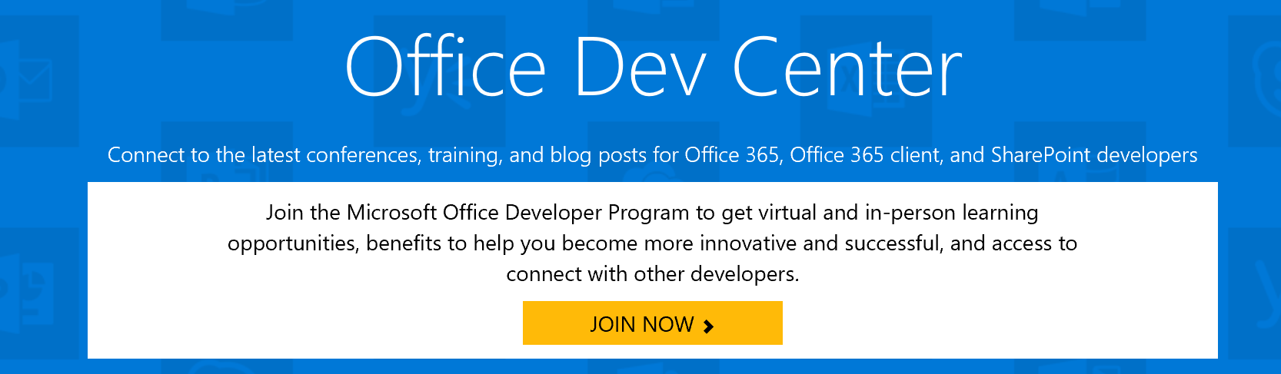
Checklist before we start
Office 365 account
Installed toolchains:
Node.js
Npm
Yeomen
TypeScript
Gulp
Generator-SharePoint
SharePoint Online Management Shell

Slide 3











About me
@gosiaborzecka
www.gosiaborzecka.net

Slide 4
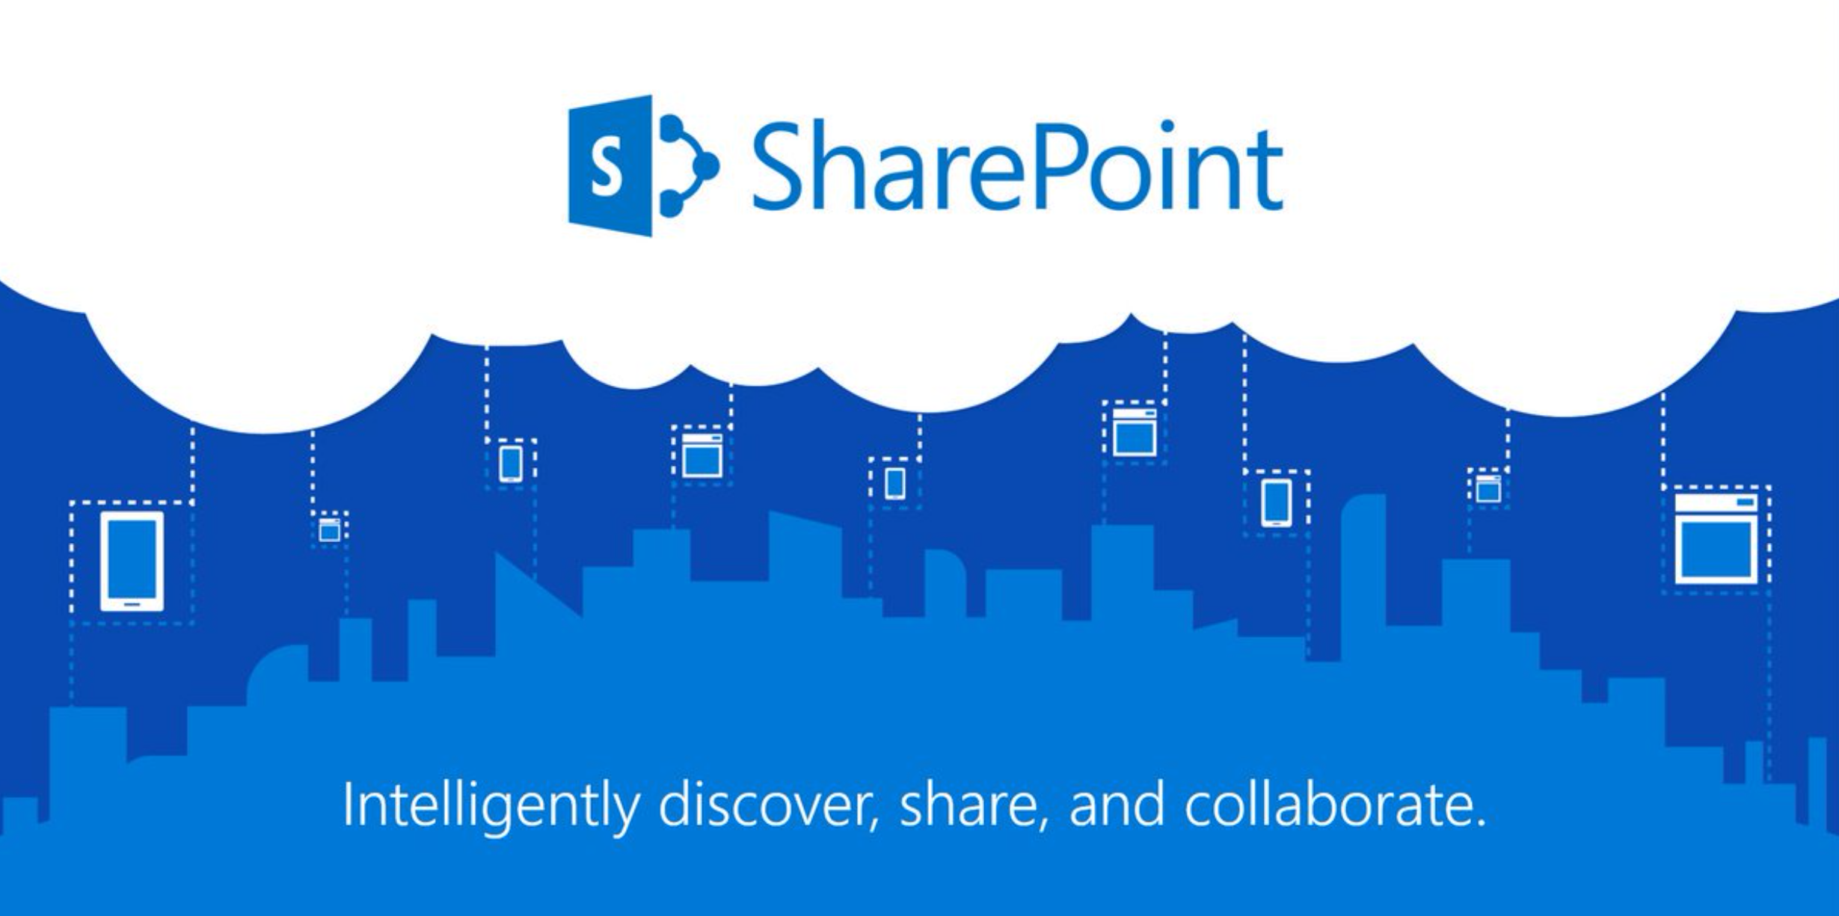
What is SharePoint?

Slide 5
SharePoint Development
Farm based
Sanboxes
SharePoint Add-ins
Manual injecting JS file

Slide 6
What is SharePoint Framework?
Client-side SharePoint development
Open Source tooling
Responsive and mobile-ready
Works for SharePoint Online and SharePoint on-premises

Slide 7


Toolchain

Slide 8
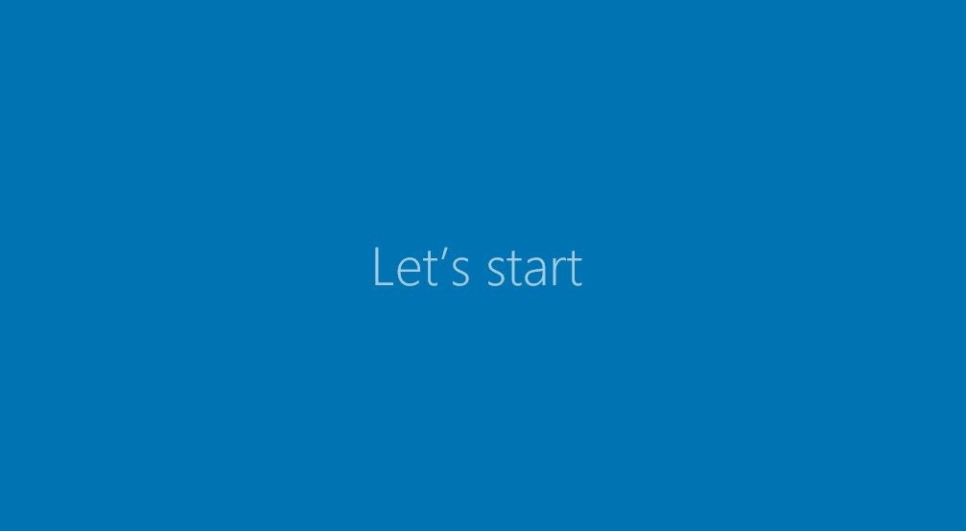

Slide 9
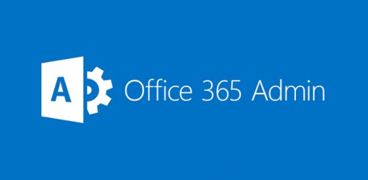
Office365 – SharePoint Online

Slide 10
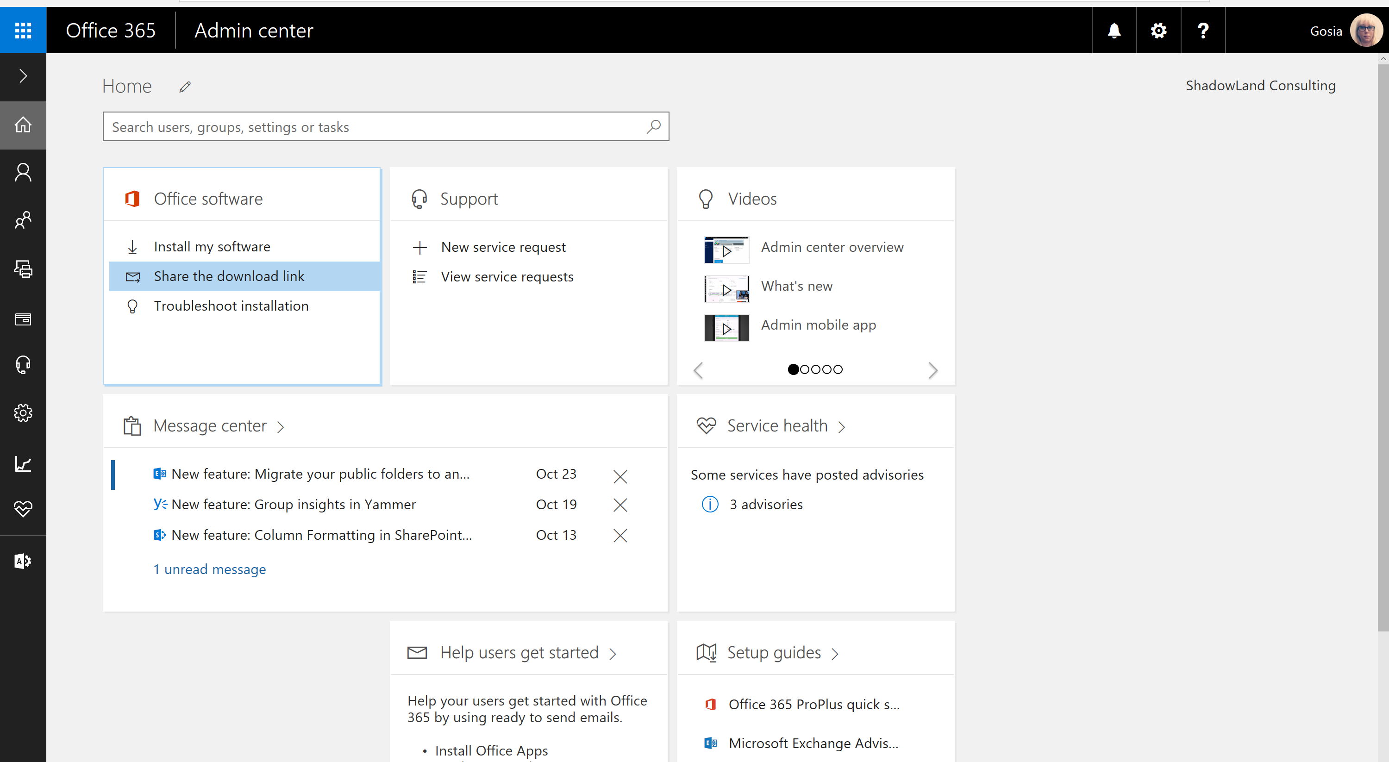

Slide 11
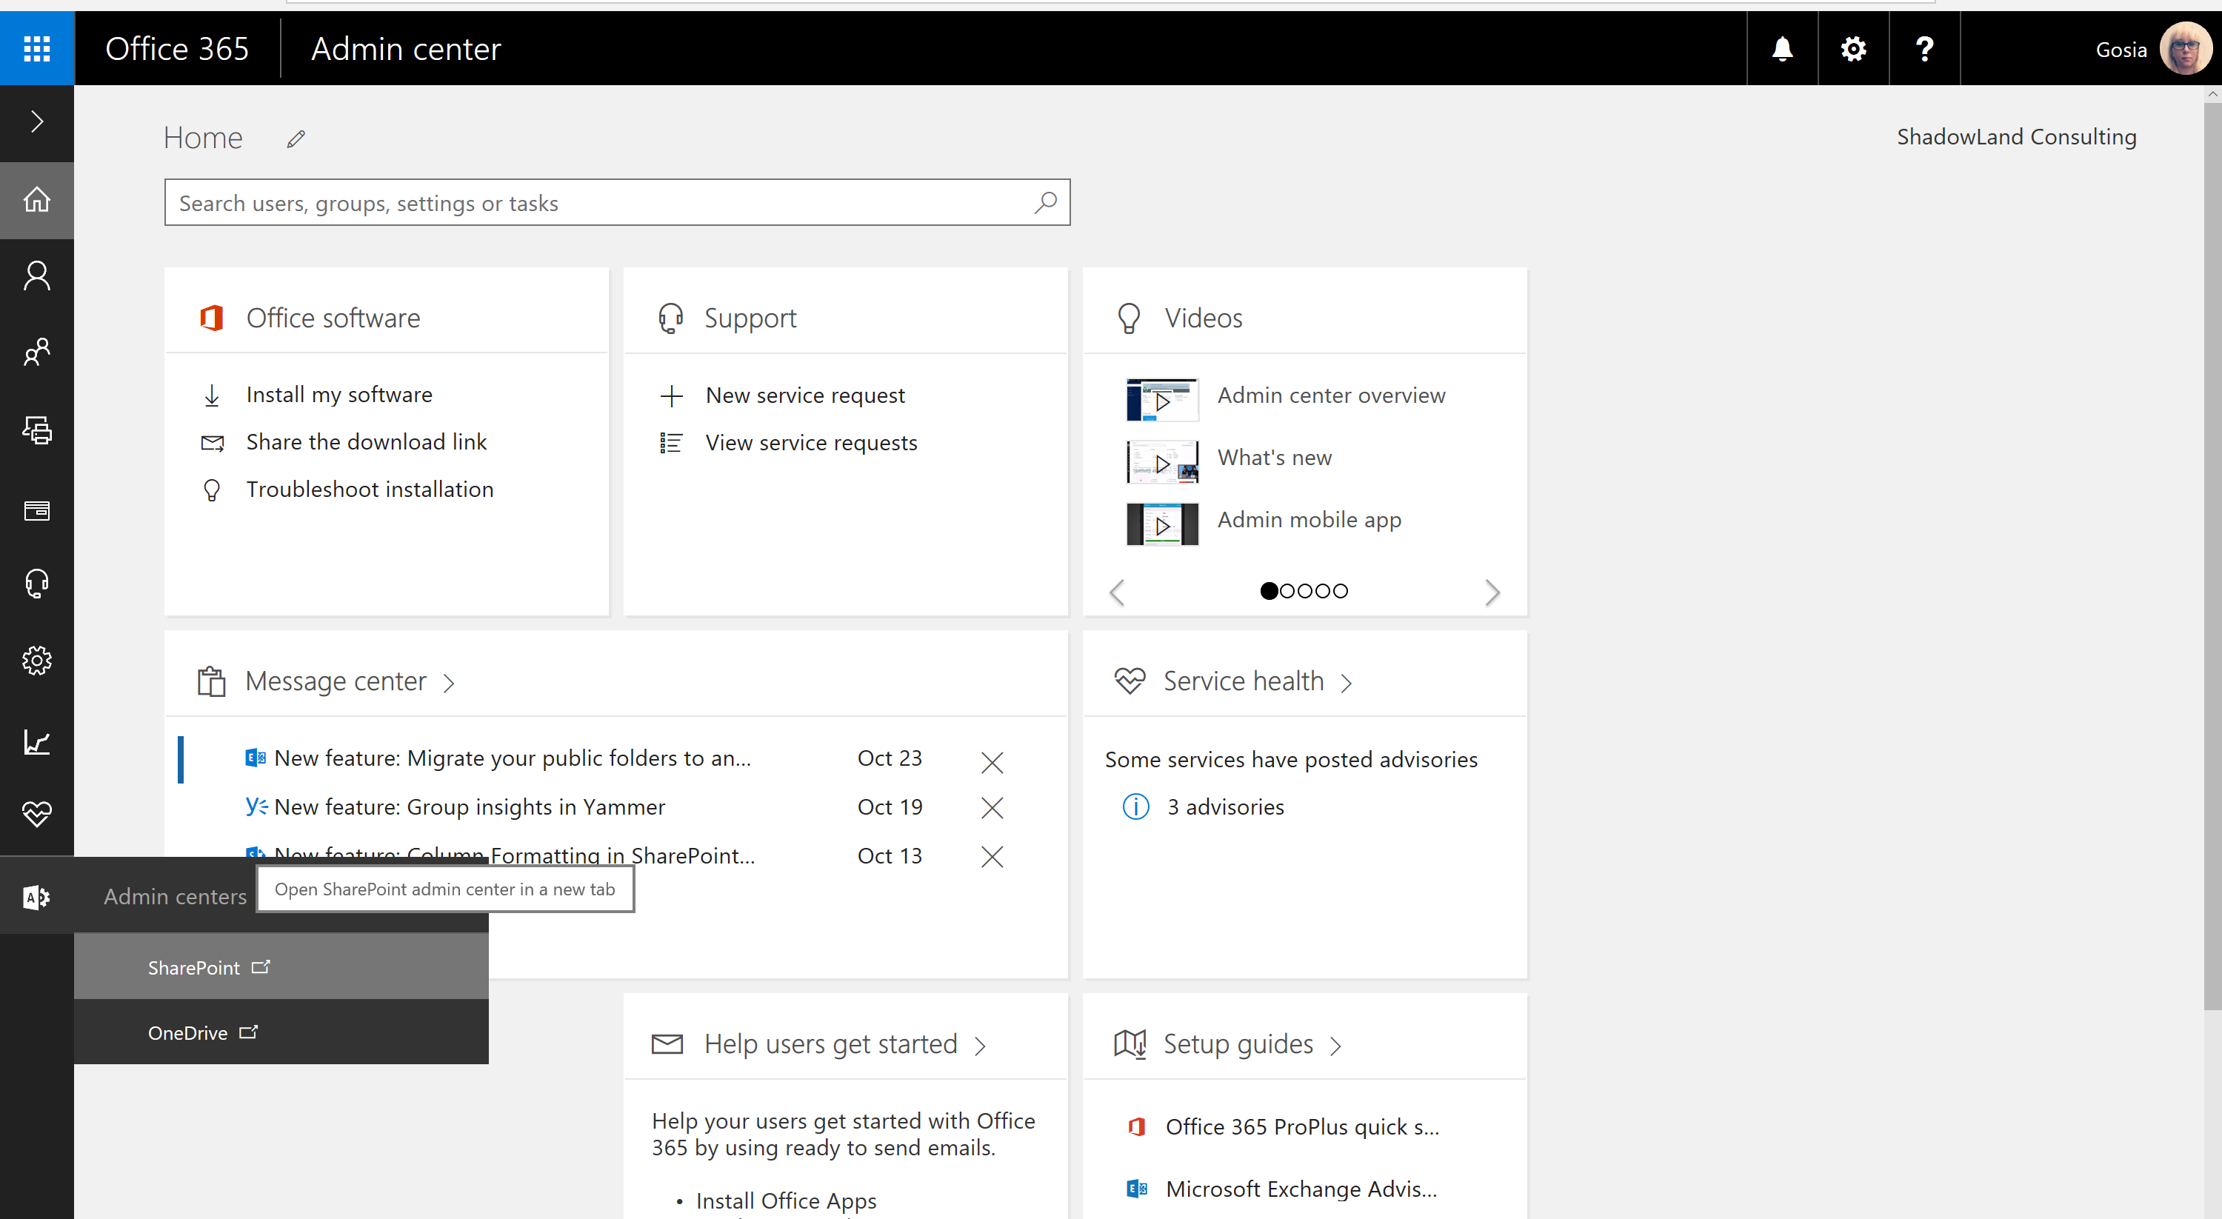

Slide 12
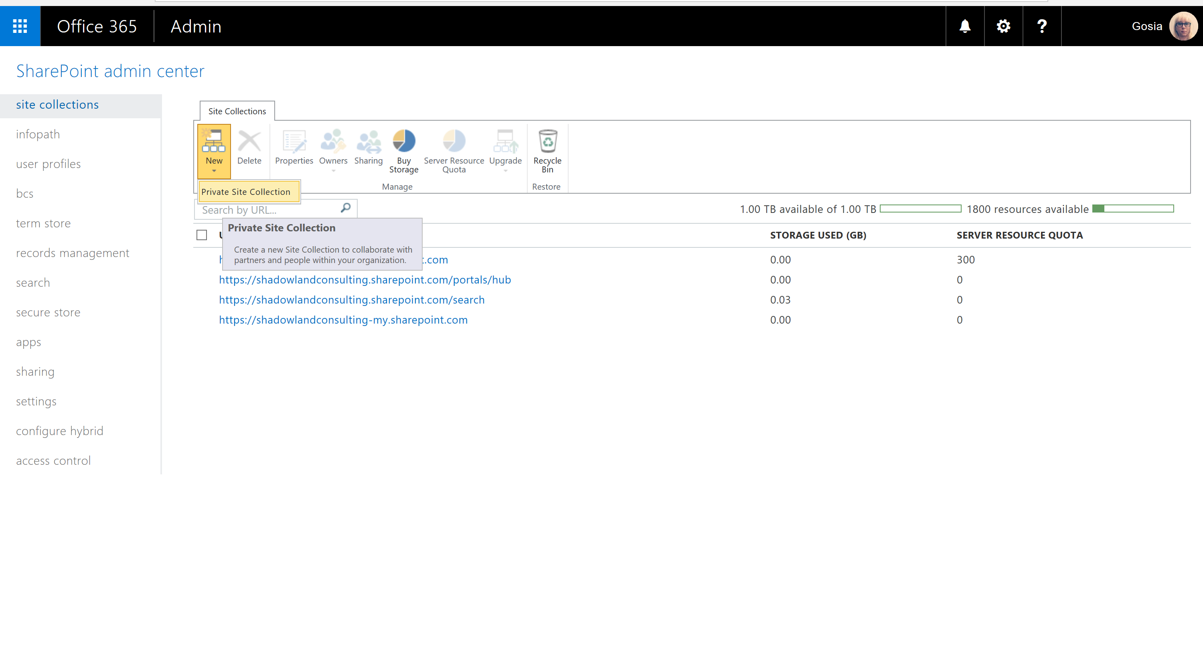

Slide 13
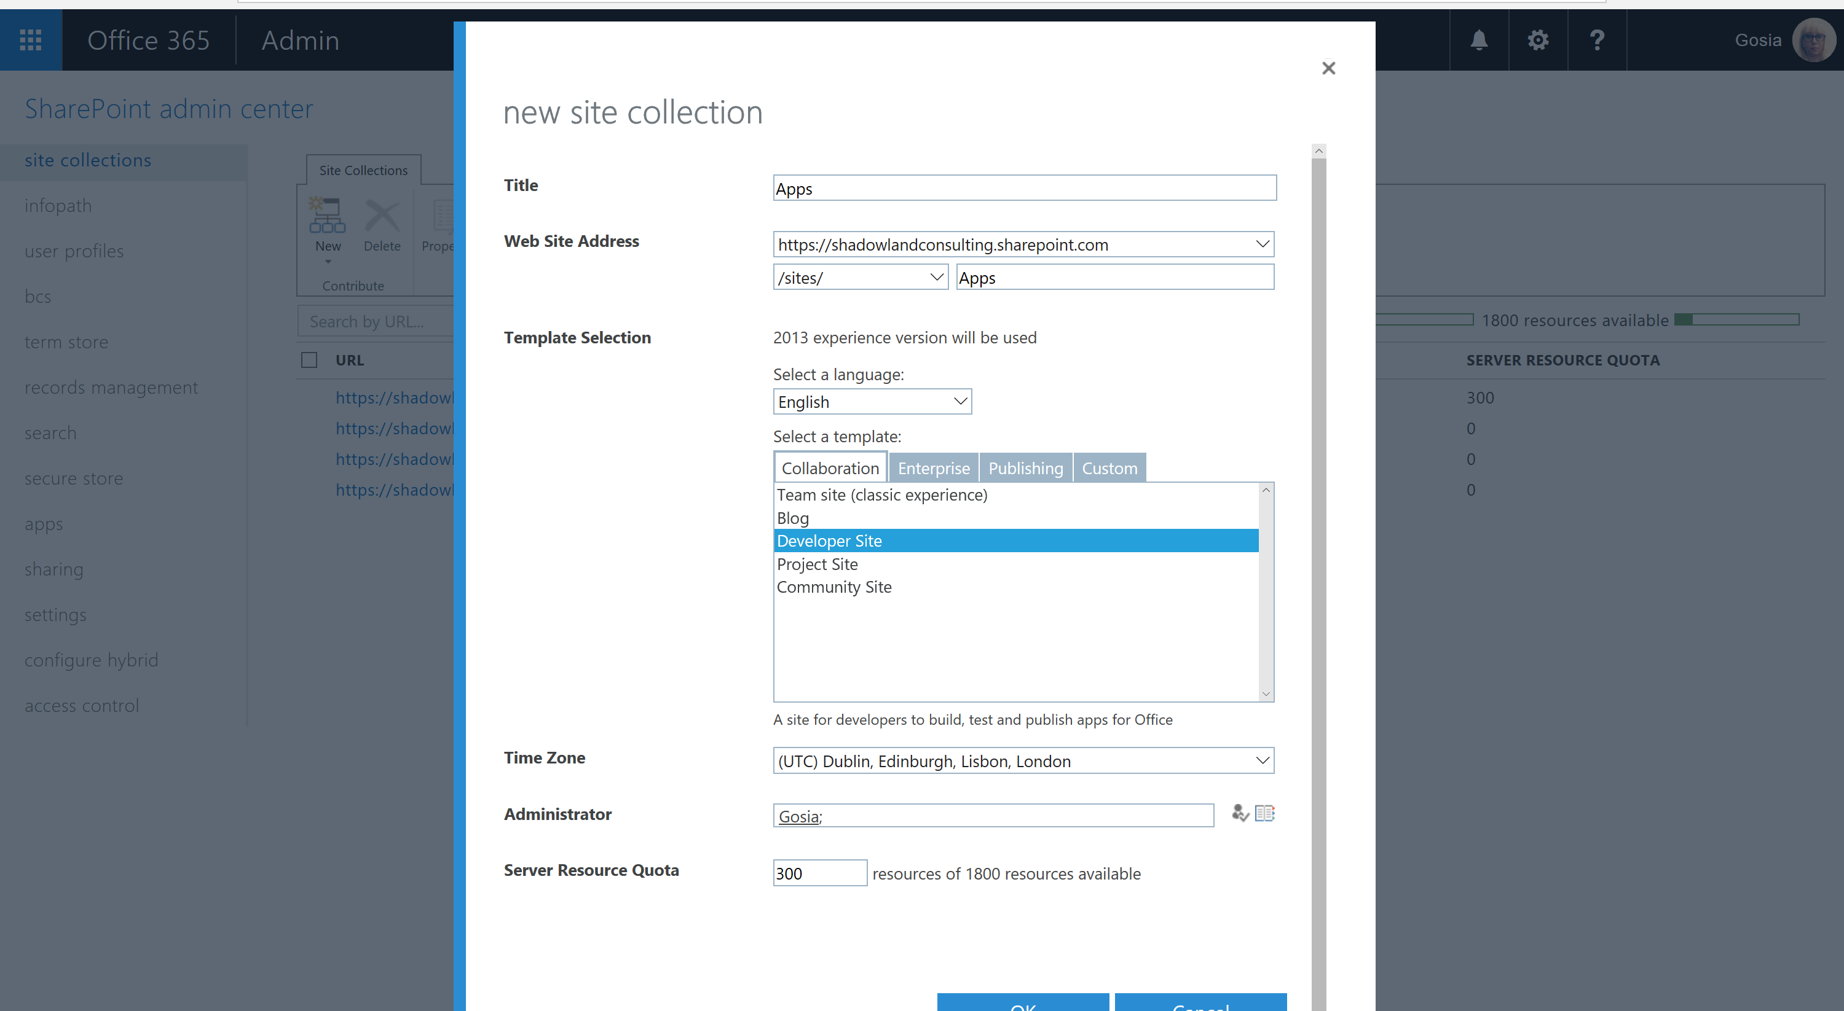

Slide 14
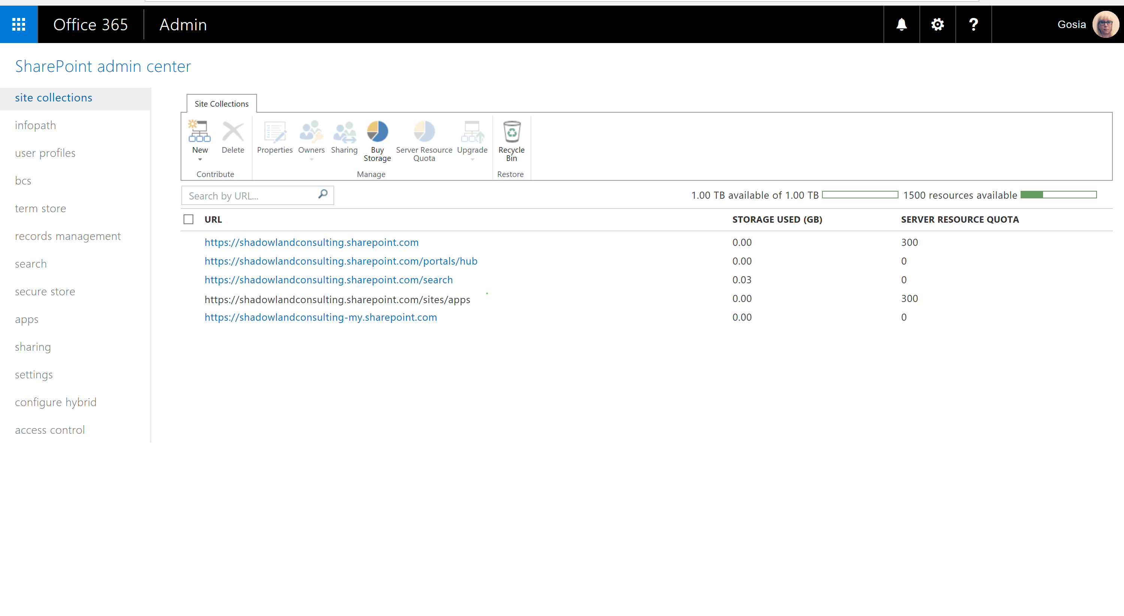

Slide 15
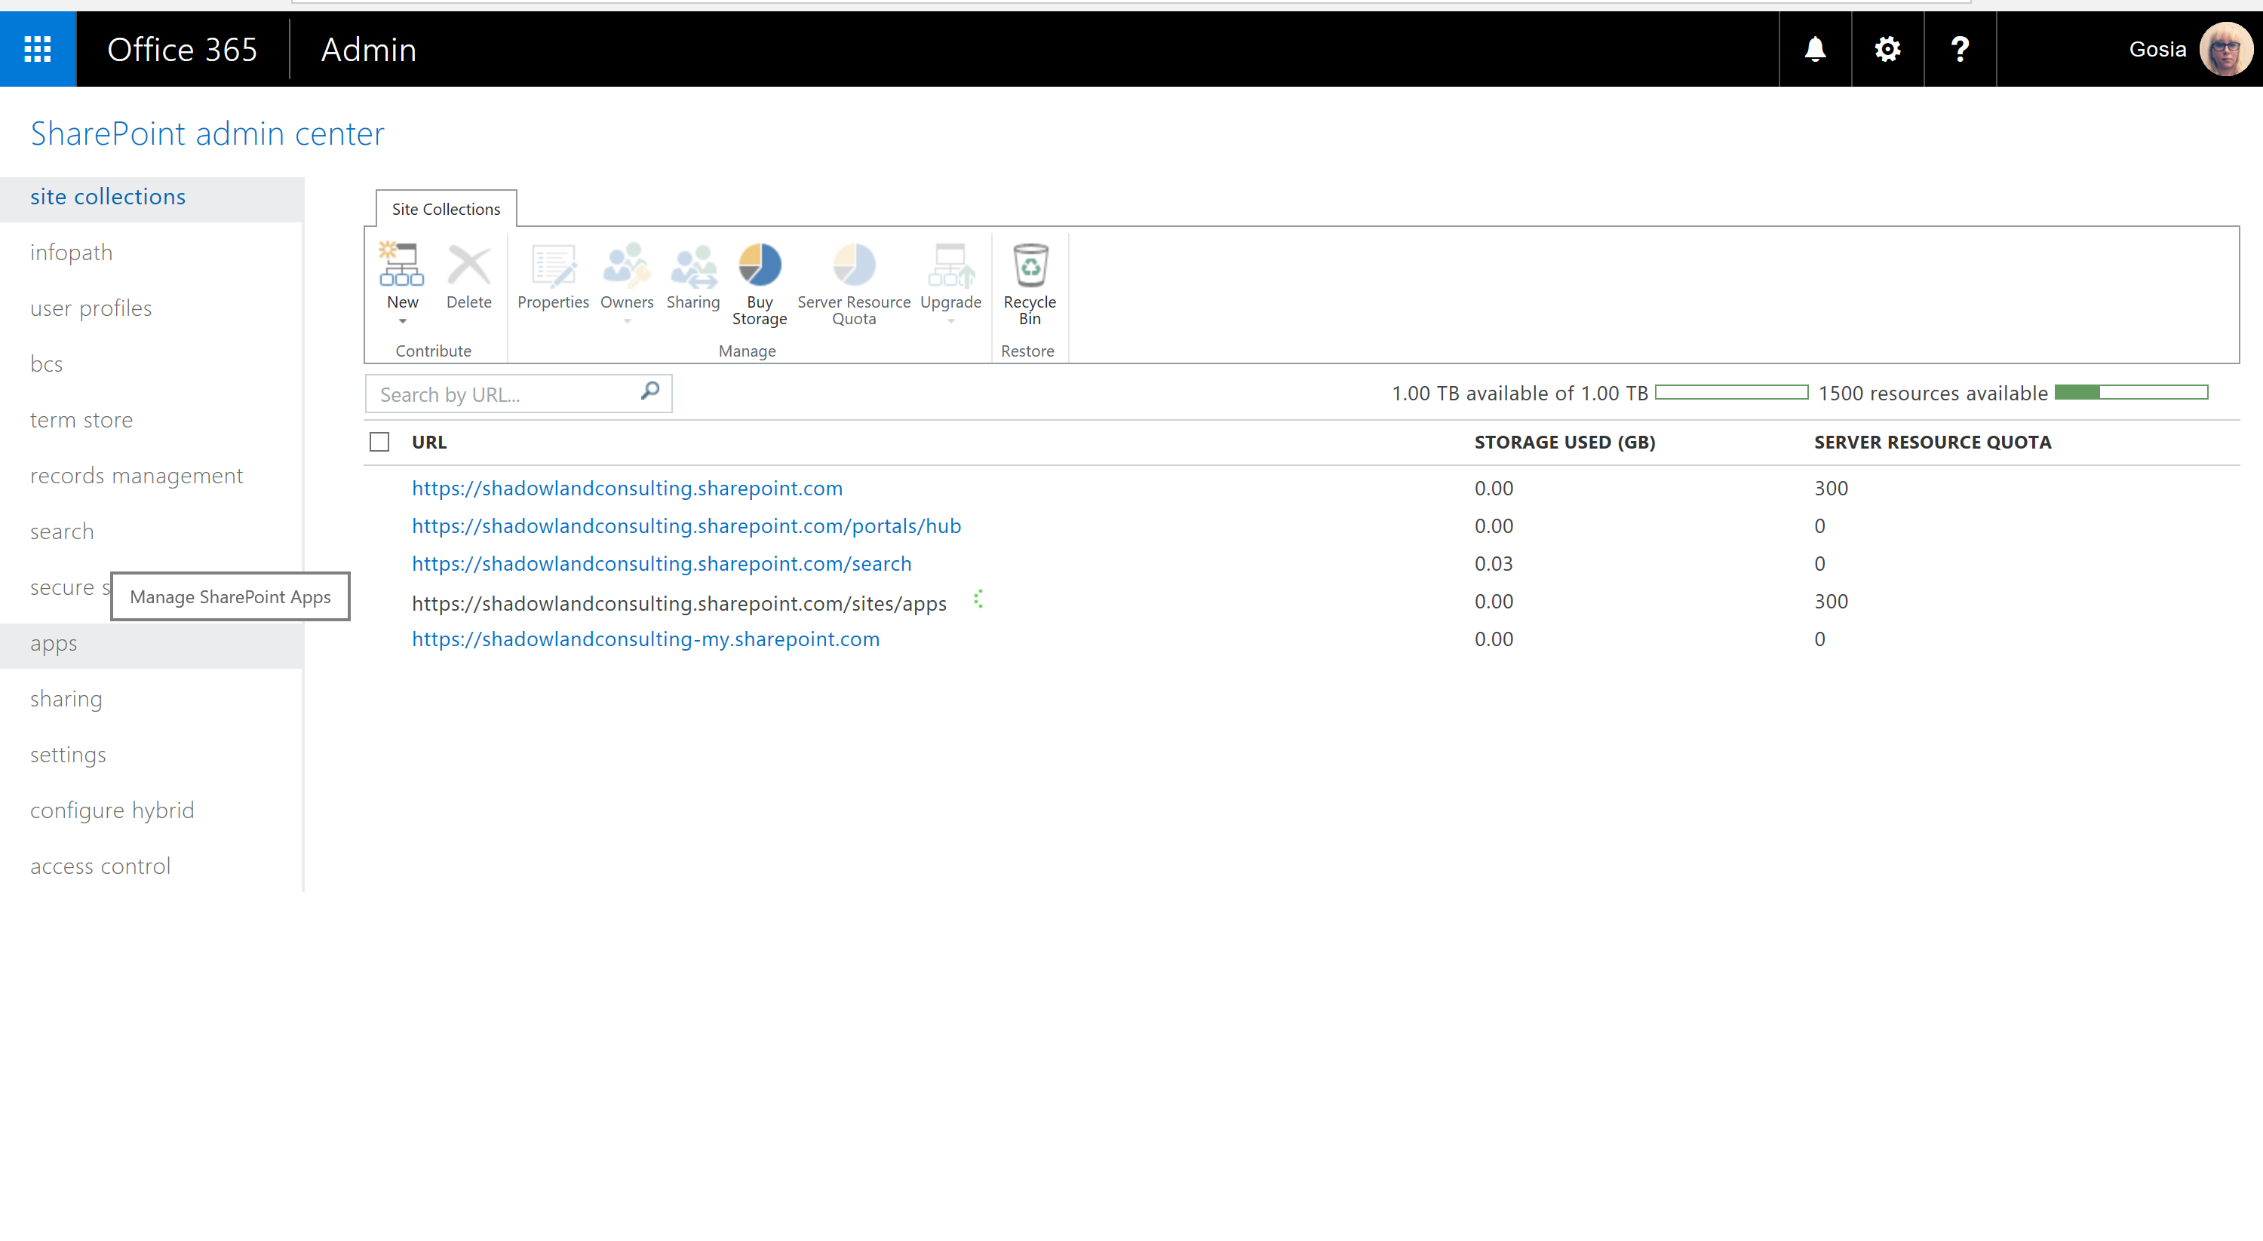

Slide 16
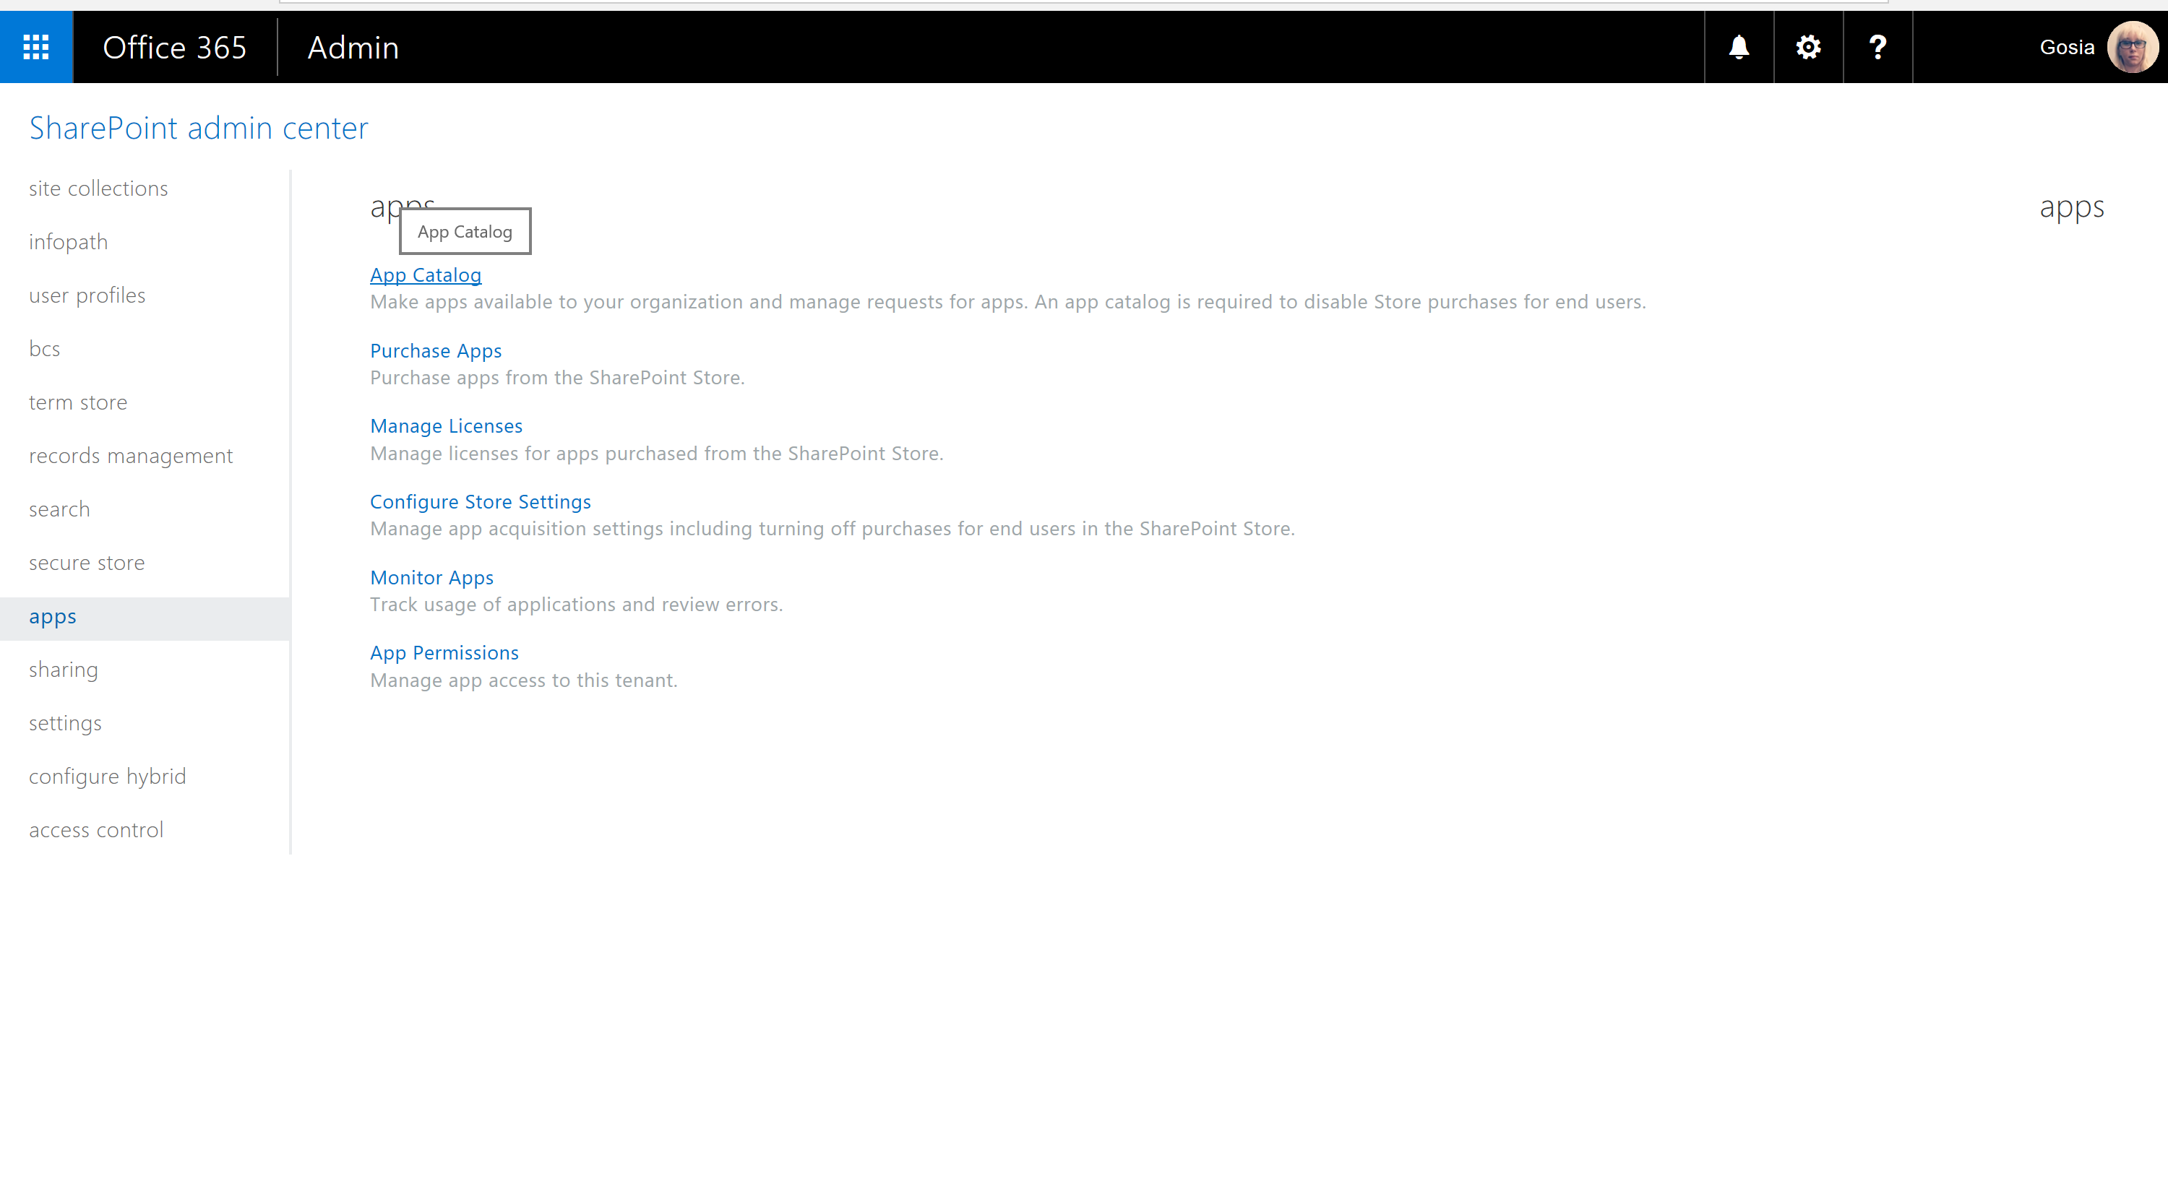

Slide 17
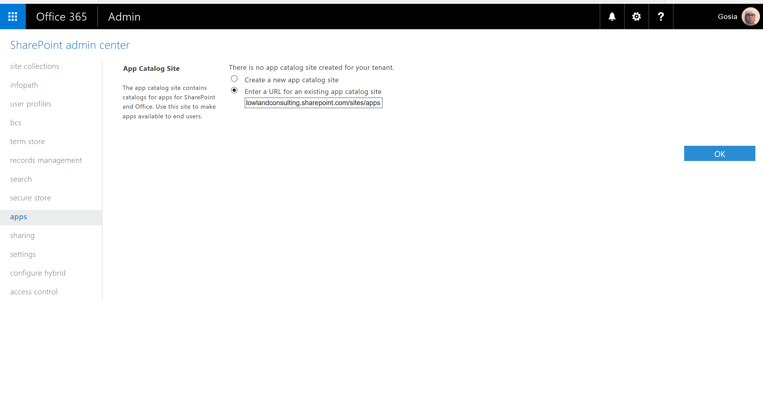

Slide 18


Slide 19
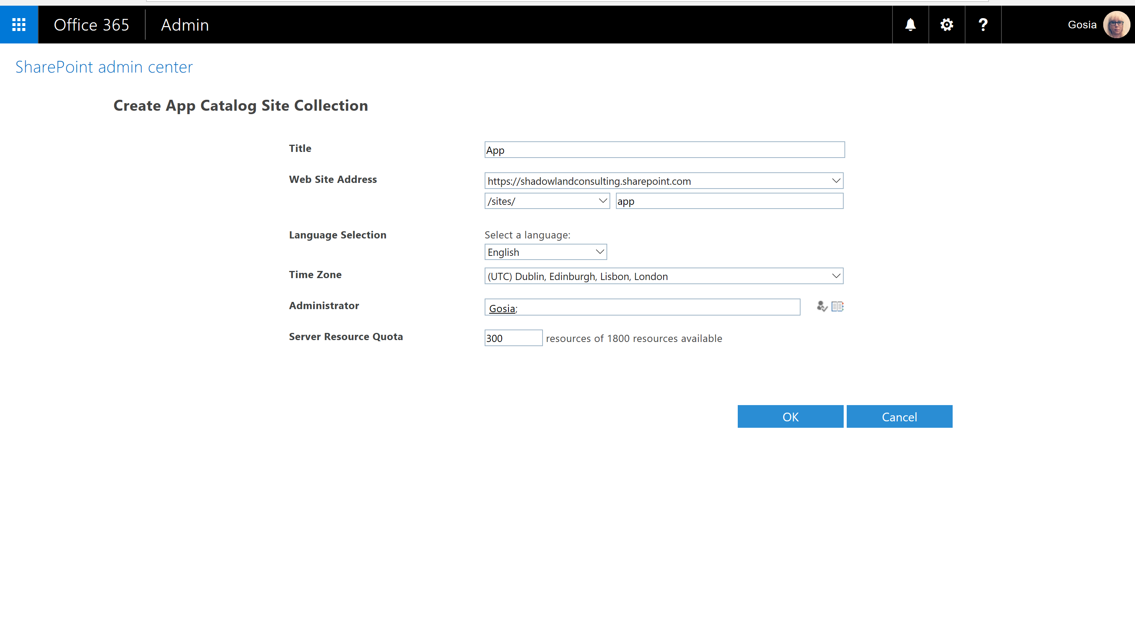

Slide 20
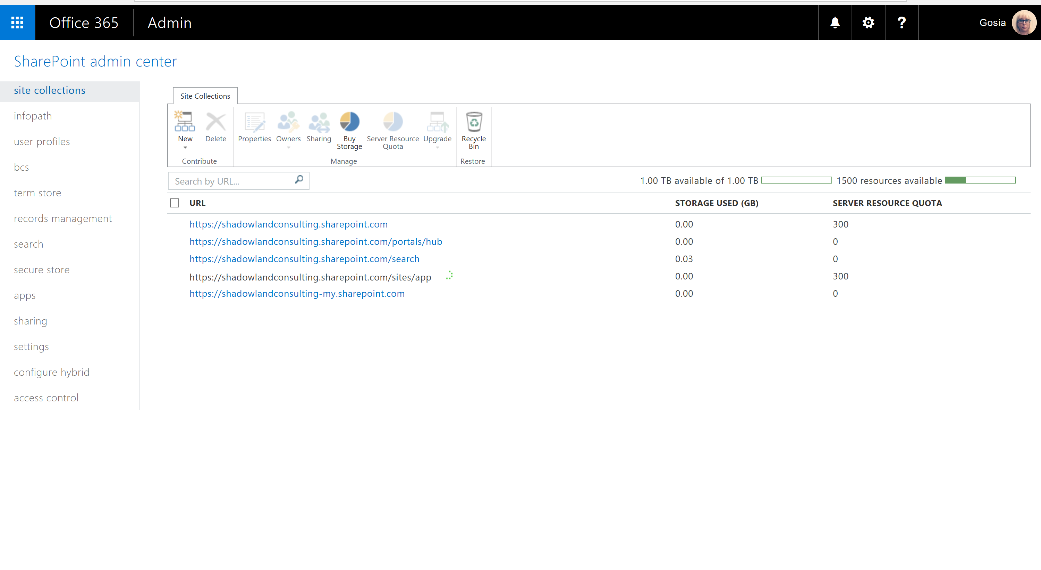

Slide 21


Slide 22
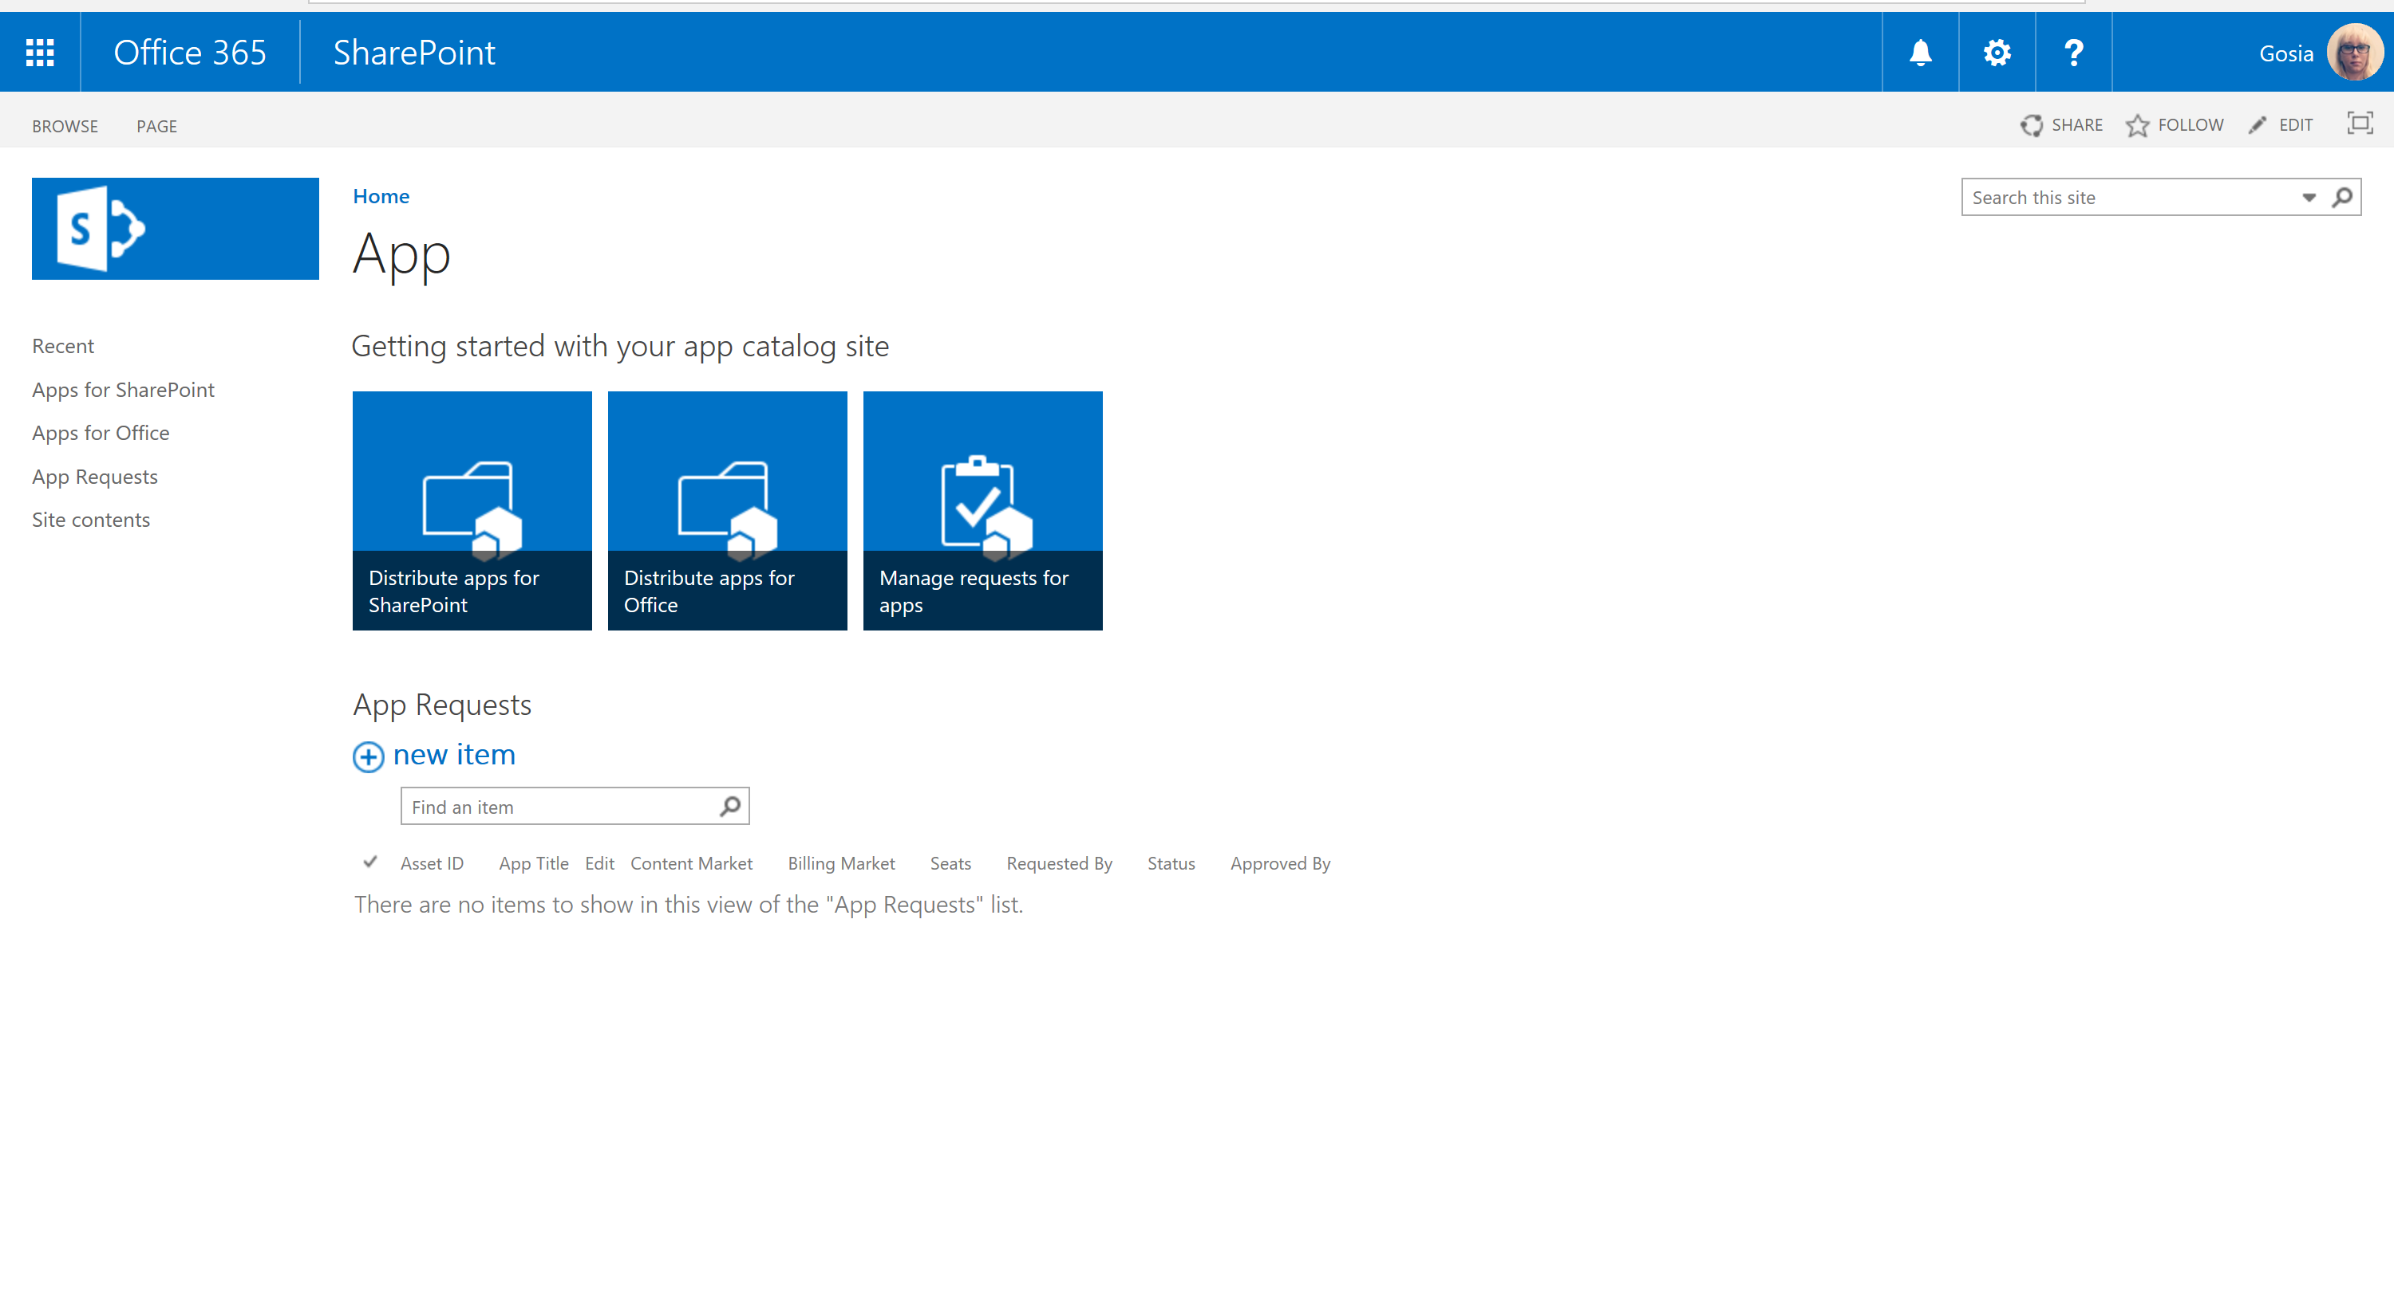

Slide 23
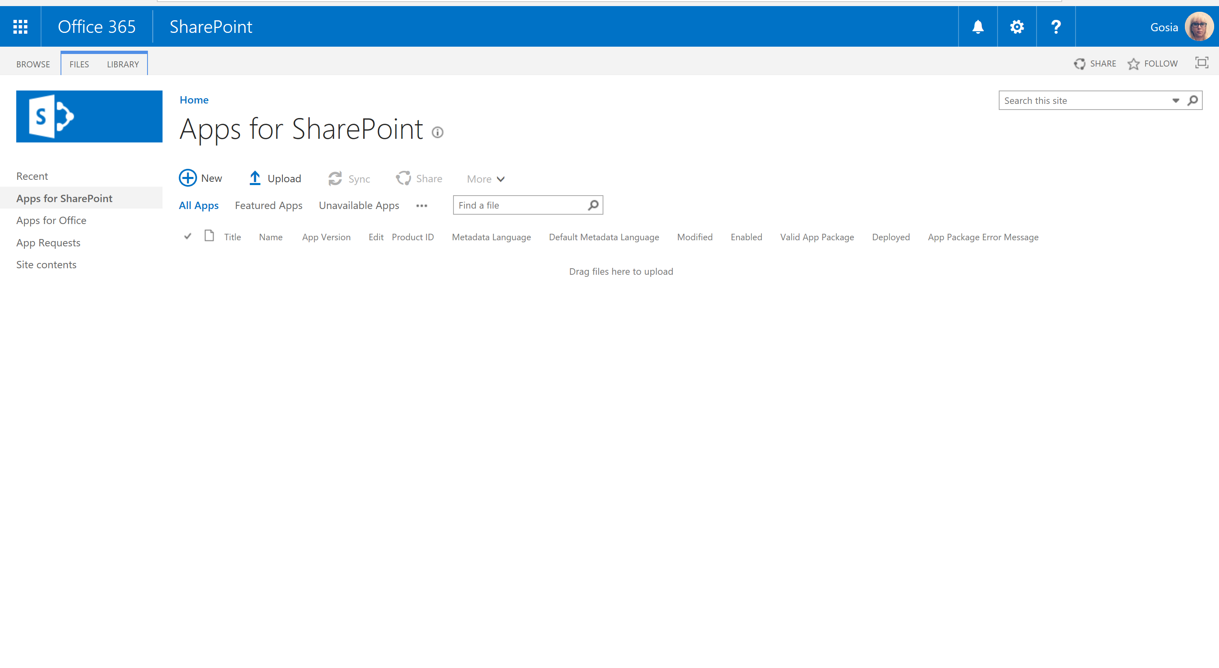

Slide 24
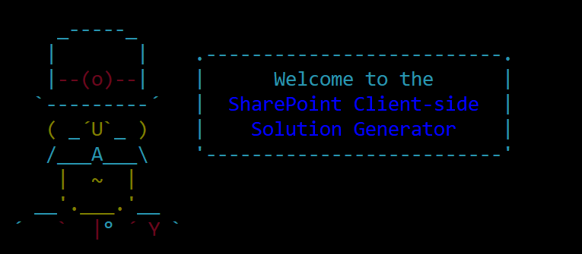

yo @microsoft/sharepoint

Slide 25
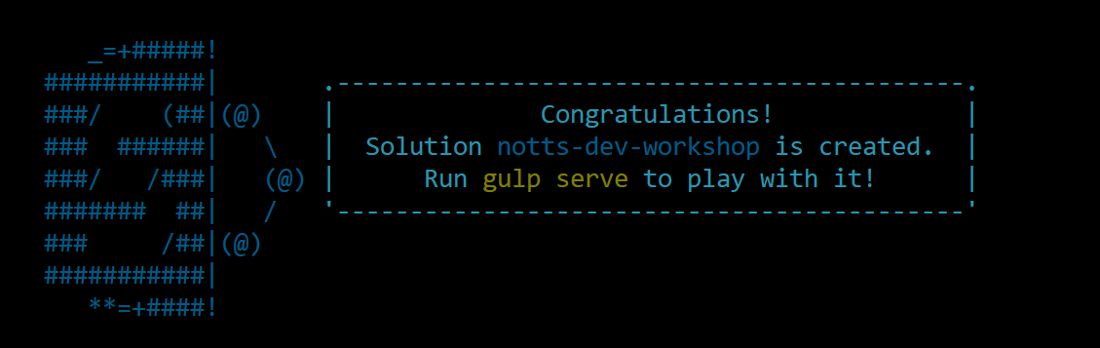
Demo summary
Creating new No JS WebPart
Local workbench: https://localhost:4321/temp/workbench.html
Hosted workbench: https://SharePointSite/.../_layouts/15/workbench.aspx
Environment Type:
Test
Local
ClassicSharePoint
SharePoint
Display mode:
Read
Edit
Page context
Debugging
Logging:
Info
Warn
Error
Verbose

Slide 26
Deploy | Office365 Shell
http://bit.ly/spfxgosiagit
> $creds = Get-Credential
> Connect-SPOService -Url https://<TENANCY>-admin.sharepoint.com/ -Credential $creds
> Set-SPOTenant -PublicCdnEnabled $true
> Set-SPOTenant -PublicCdnAllowedFileTypes "CSS,EOT,GIF,ICO,JPEG,JPG,JS,MAP,PNG,SVG,TTF,WOFF,TXT"
> New-SPOPublicCdnOrigin -Url "https://<TENANCY>.sharepoint.com/sites/<SITE>/siteassets/cdn"
> Get-SPOPublicCdnOrigins

Slide 27
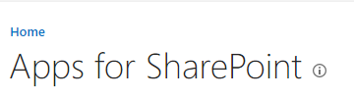
Deploy on Office365

Slide 28
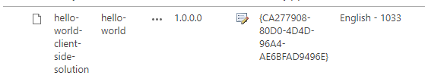
Demo summary
https://publiccdn.sharepointonline.com/<TENANCY>.sharepoint.com/<your-CDN-origin-Id> -> write-manifests.json
Commads:
gulp bundle –ship
gulp package-solution-ship
File location:
…\temp\deploy (copy to CDN)
…\sharepoint\solution\<webpartname>.sppkg (deploy on app site)
Checking on:
Modern Page
Classic Page

Slide 29
New WebPart

Slide 30
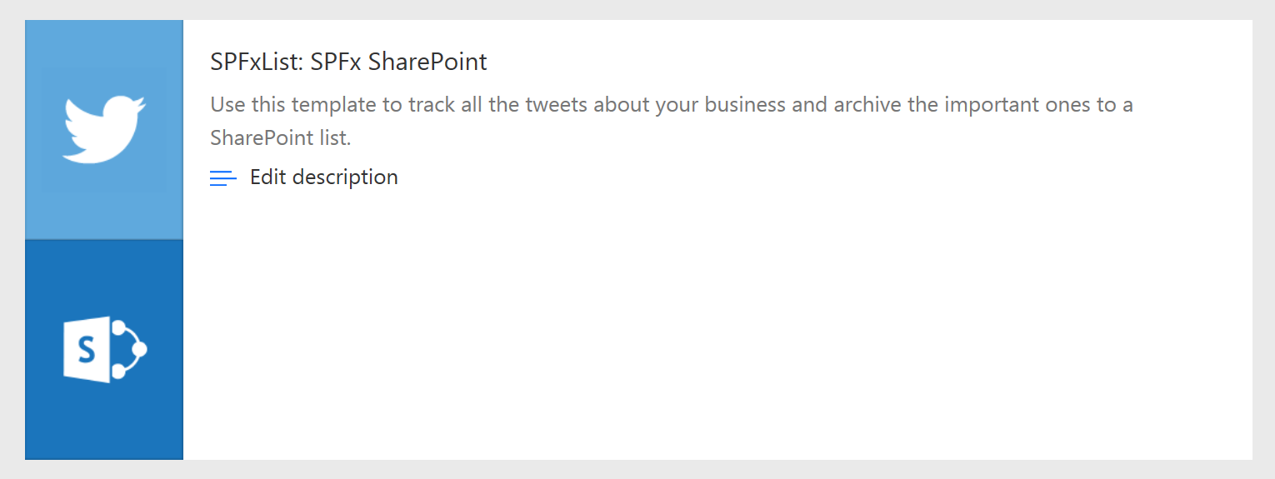
Demo summary
New list
Flow
MockHttp
HttpClient

Slide 31



Office UI Fabric
Fonts, icon
Component
Colour
Front-end experiences for SharePoint
Powers Microsoft’s own experiences
Available out-of-the-box
Design web parts seamlessly
Office UI Fabric React includes a rich set of reusable controls

Slide 32
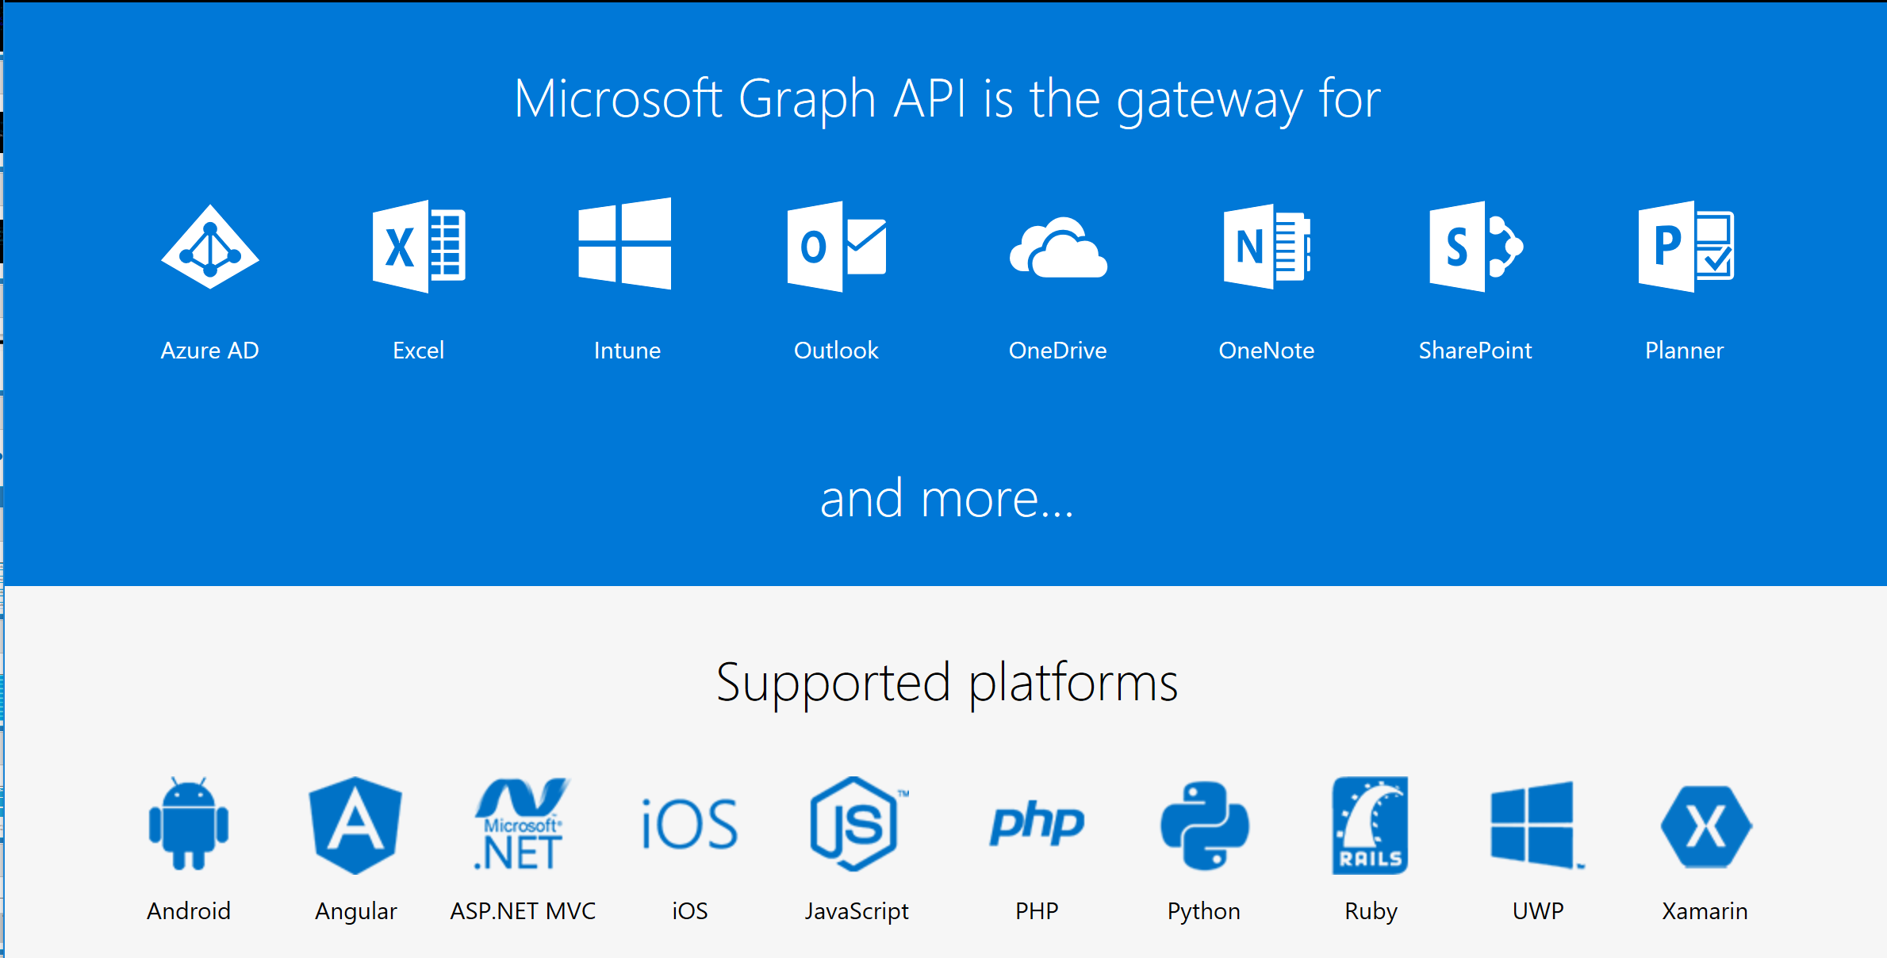
Microsoft Graph

Slide 33
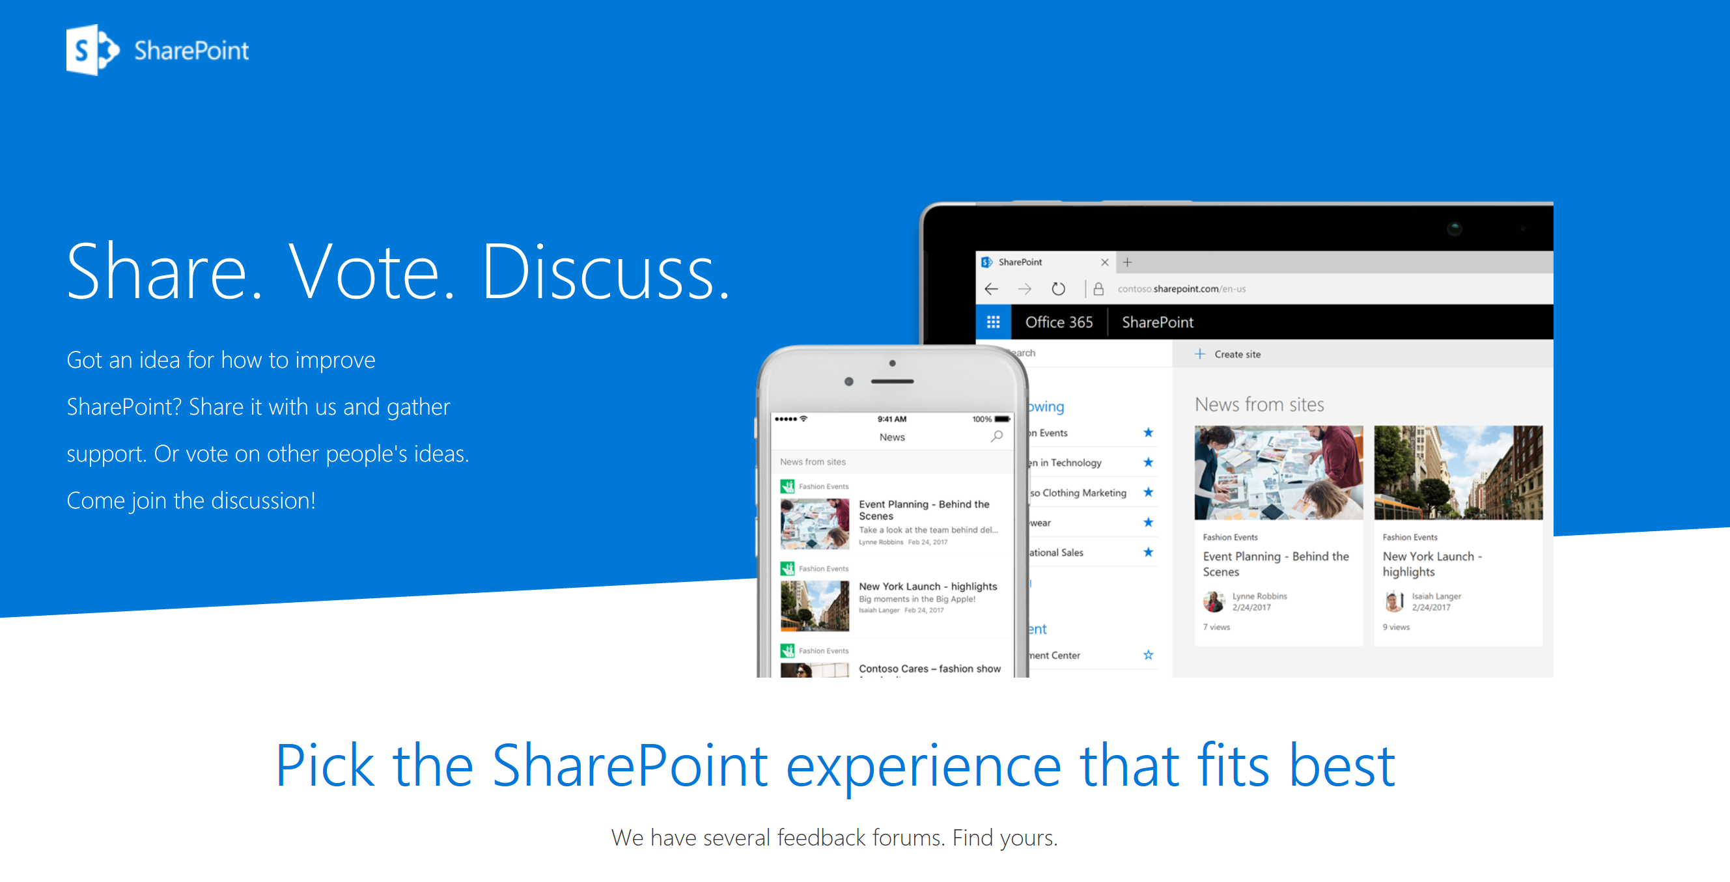
https://sharepoint.uservoice.com/

Slide 34
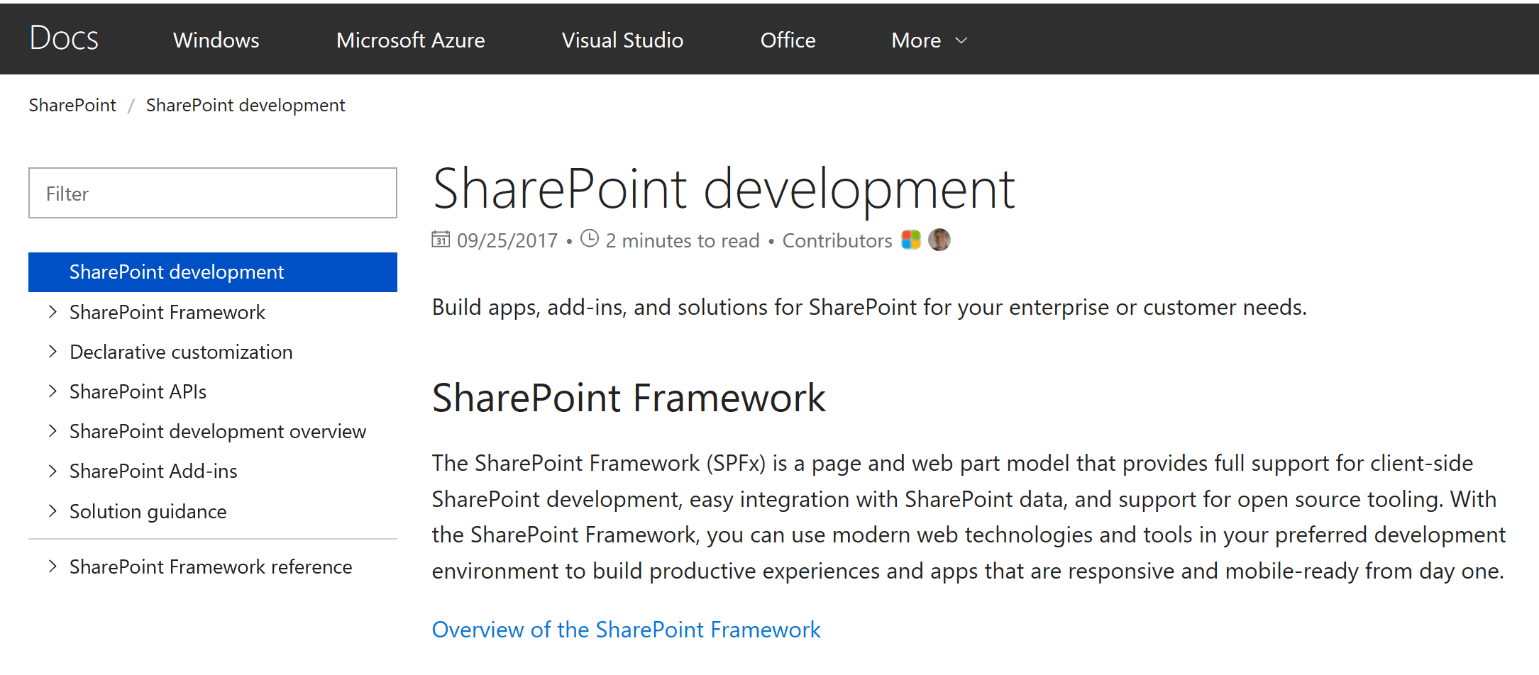
https://docs.microsoft.com/en-us/sharepoint/dev/

Slide 35
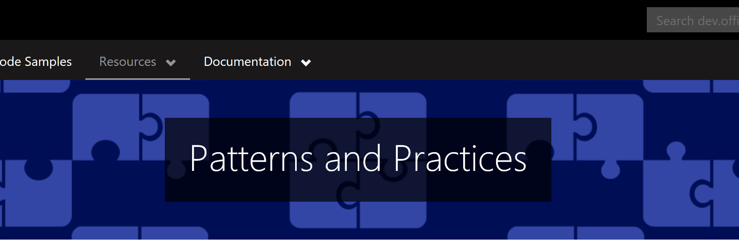
https://dev.office.com/patterns-and-practices

Slide 36
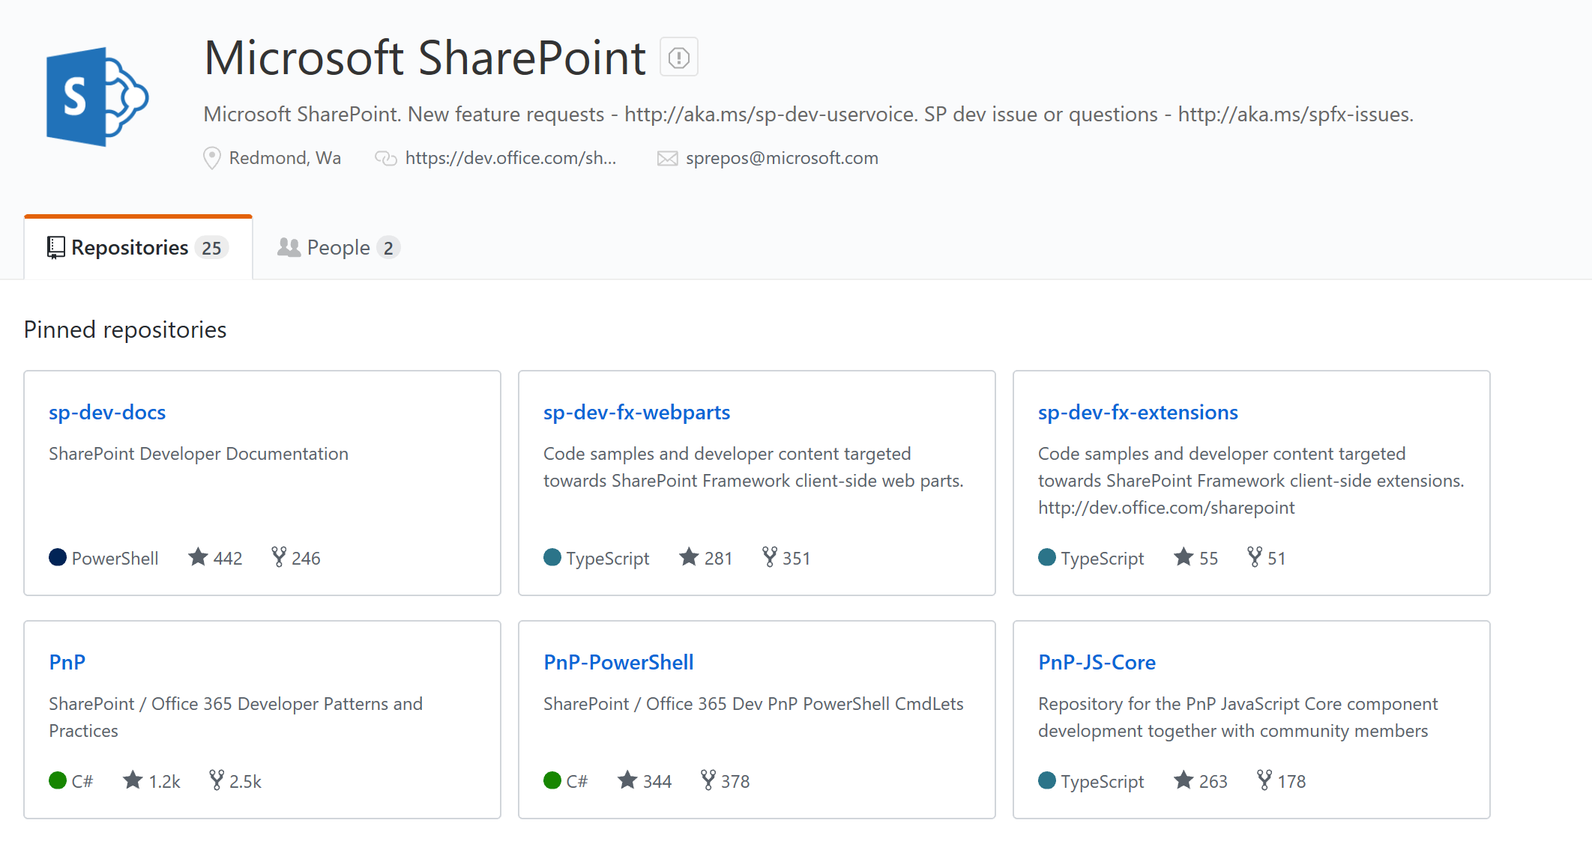
https://github.com/SharePoint/

Slide 37
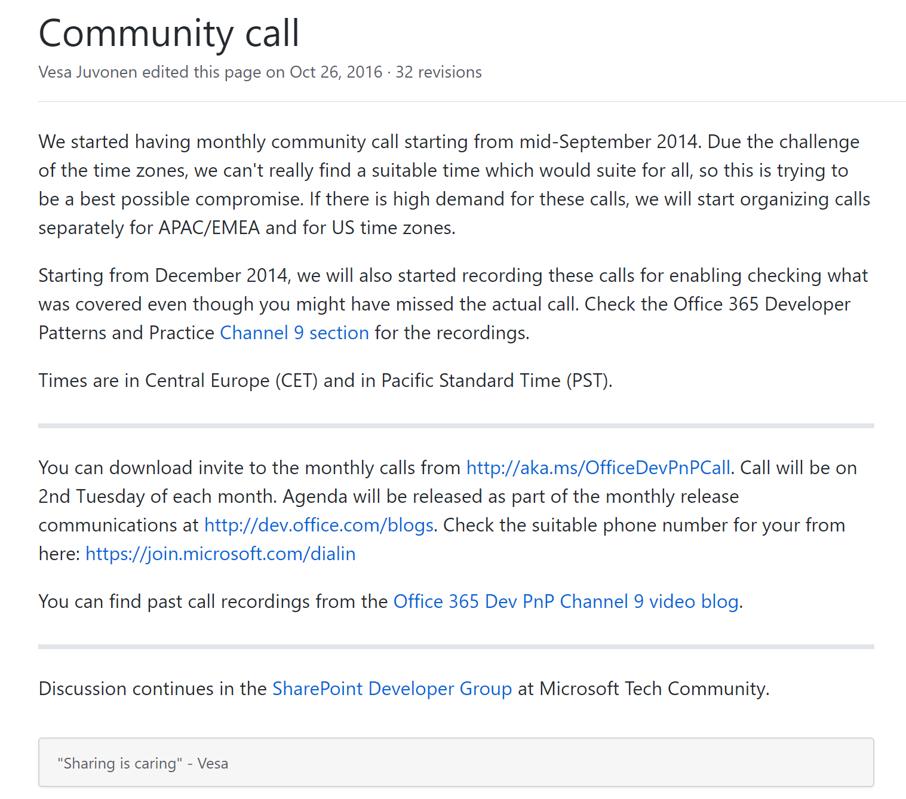
https://github.com/SharePoint/PnP/wiki/Community-call

Slide 38

http://uk.communities.tech/events/spfx-bootcamp-uk-community-day/

Slide 39
Thank you!

